Slide 1
ENGINEERING SCIENCE MATERIALS [ME232AT]

Slide 2
ENGINEERING SCIENCE MATERIALS
It all about the materials and how they are processed
That is why we call it materials ENGINEERING
Minor differences in Raw materials or processing parameters can mean major changes in the performance of the final material or product

Slide 3
Course Overview
Course Code: ME232AT | Hrs/Week:L:T:P:S: 3:0:0 | Credits: 03
CIE Marks: 100 | SEE Marks: 100 | SEE Duration: 3 Hrs

Slide 4
Syllabus
Unit-I
The Fundamentals of Materials : The electronic structure of atoms, Types of atomic and molecular bonds; ionic bonding; covalentbonding; metallic bonding; secondary bonding; mixed bonding; hybridization. Energy bands in metals,insulators, and semiconductors. Basic crystallography. Defects and dislocations. Types of Materials:Polymers, metals and alloys, semiconductors, ceramics, composites
Unit-II
Material Behaviour: Conductivity, thermal properties, thermal conductivity, thermoelectric effects. Dielectric behaviours andtemperature dependence of the dielectric constant, insulating materials, ferroelectricity, piezoelectricity. thermocouple, super conductor, optical properties. Stress-strain, Elastic deformation, plasticdeformation, hardness, viscoelastic deformation, impact energy, Fracture toughness, Fatigue, Heatcapacity, Thermal expansion, Thermal conductivity, thermal shock

Slide 5
Unit-III
Materials and their Applications : Semiconductors, Dielectric, optoelectronics and structural materials, Ferrous alloys, Nonferrous alloy,cement, concrete, ceramic and glasses, processing the structural Materials, polymers, Thermoset and thermoplastic polymers, composites: fibre-reinforced, aggregated composites, mechanical properties ofcomposites, Electronic Packaging Materials, Biomaterials
Unit-IV
Heat Treatment: Post Processing heat treatment of electronic devices for long duration, Thermal Oxidation, Diffusion,Rapid Thermal Processing for electronic devices, Heat treatment, stress relieving, Annealing,spherodizing, Normalizing, hardening, Tempering process, Ferrous heat treatment, formation of austenite of heating, construction of Time Temperature Transformation curves. Special heat treatment such as carburizing, nitriding, Cyaniding, Surface hardening, Flame and induction hardening, defect in the heat treatment
Unit-IV
Nanomaterials: Introduction, Synthesis of Nanomaterials: ball milling, Solgel, Vapour deposition growth, pulse laser,Magnetron sputtering, lithography. Nano porous Materials such Zeolites, mesoporous materials, carbon
nanotubes and graphene. Characterisation such as Nano structure, spectroscopic technique, automatic force microscopy, FRPs, fabrics bioresorbable and bio-erodable materials, ceramic, glasses,biomaterials: biocompatibility, implant associated materials.

Slide 6
Course outcome
CO1 | Understand behaviour of various materials such as metals, composites and special materials
CO2 | Analyse materials, composition, and their phase transformation
CO3 | Investigate solidification process during casting and materials degradation
CO4 | Recognize different types of Non-destructive testing methods to find subsurface defects in the materials.

Slide 7
Reference Books
Material Science and Engineering, William D Callister, 6th Edition, 1997, John Wiley and Sons,
ISBN: 9812-53-052-5
Introduction to Physical Metallurgy, Sydney H Avner, 1994, Mc. Graw Hill Book Company, ISBN: 0-07-Y85018-6
Material Science and Engineering, William F Smith, 4th Edition, 2008, Mc. Graw Hill Book Company, ISBN: 0-07-066717-9

Slide 8
Introduction
Materials: Substances from which something is composed or made.
Material Science: The discipline of investigating the relationships that exist between the structures and properties of materials.
Engineering Materials: Materials we use to build your material world: Appliances, bridges, devices, electricity system, machines, roads, tools, furniture, etc…

Slide 9
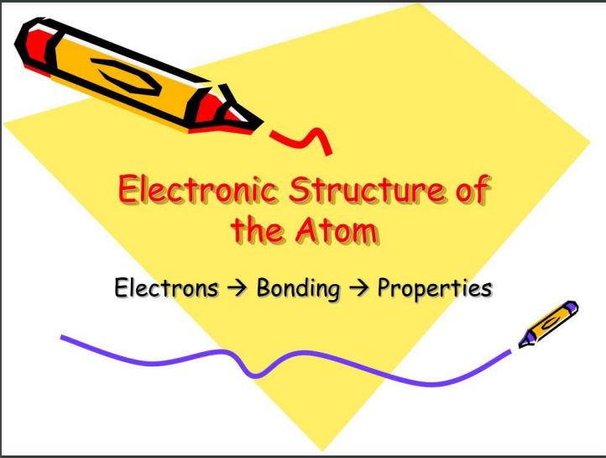

Slide 10
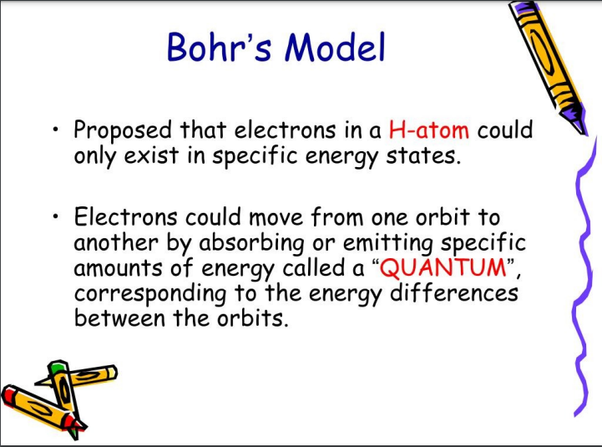

Slide 11
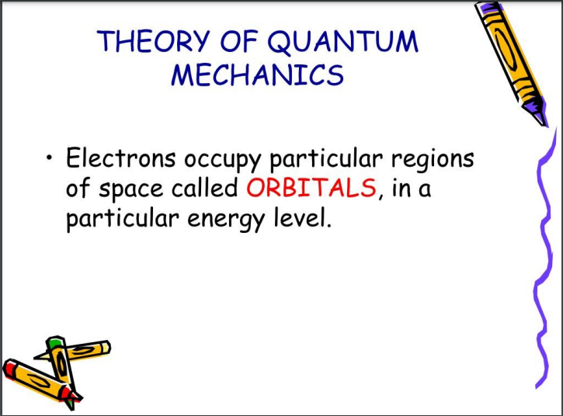

Slide 12
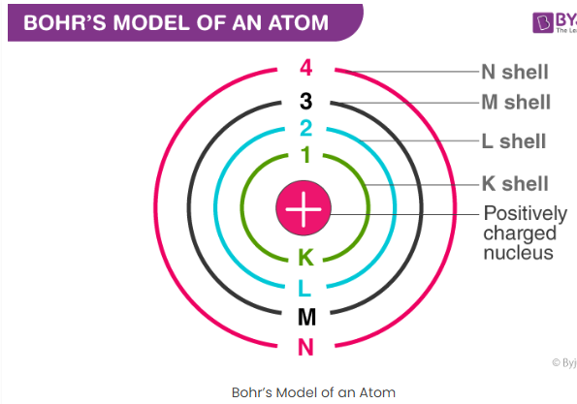

Slide 13
Postulates of Bohr’s Model of an Atom
In an atom, electrons (negatively charged) revolve around the positively charged nucleus in a definite circular path called orbits or shells.
Each orbit or shell has a fixed energy and these circular orbits are known as orbital shells.
The energy levels are represented by an integer (n=1, 2, 3…) known as the quantum number. This range of quantum number starts from nucleus side with n=1 having the lowest energy level. The orbits n=1, 2, 3, 4… are assigned as K, L, M, N…. shells and when an electron attains the lowest energy level, it is said to be in the ground state.
The electrons in an atom move from a lower energy level to a higher energy level by gaining the required energy and an electron moves from a higher energy level to lower energy level by losing energy.

Slide 14
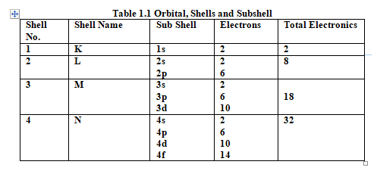

Slide 15
Shells
Shell (electron): A grouping of electrons in an atom according to energy.
The farther a shell is from the nucleus, the larger it is, the more electrons it can hold, and the higher the energies of those electrons.
The first shell (closest to the nucleus) can hold two electrons. The second shell can hold 8 electrons. The third shell can hold 32 electrons.
Within the shells, electrons are further grouped into subshells of four different types, identified as s, p, d, and f in order of increasing energy.
The first shell has only an s subshell; the second shell has an s and a p subshell; the third shell has s, p, and d subshells, and the fourth has s, p, d and f subshells.
The number of subshells is equal to the shell number. A specific subshell is symbolized by writing the number of the shell, followed by the letter for the subshell.

Slide 16
Subshell (electron):
A grouping of electrons in a shell according to the shape of the region of space they occupy.
Within each subshell, electrons are grouped into orbitals, regions of space within an atom where the specific electrons are most likely to be found.
Within each subshell, electrons are grouped into orbitals, regions of space within an atom where the specific electrons are most likely to be found.
Each orbital holds two electrons which differ in a property known as spin.

Slide 17
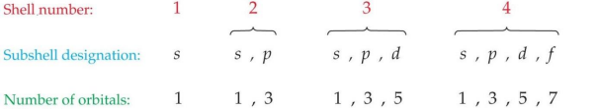
Orbital
A region of space within an atom where an electron in a given subshell can be found.
Any orbital can hold a maximum of 2 electrons with opposite spin.
The first shell has one 1s orbital and holds 2 electrons.
The second shell holds 8 electrons; 2 in a 2s orbital and 6 in three 2p orbitals.
The third shell holds 18 electrons; 2 in a 3s orbital; 6 in three 3p orbitals; and 10 in five 3d orbitals.
The fourth shell holds 32 electrons; 2 in a 4s orbital; 6 in three 4p orbitals; 10 in five 4d orbitals; and 14 in seven 4f orbitals.

Slide 18
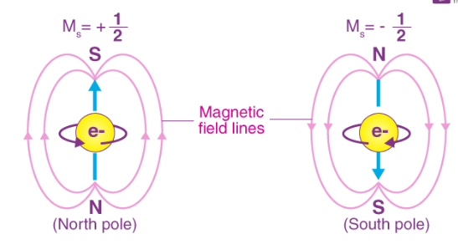
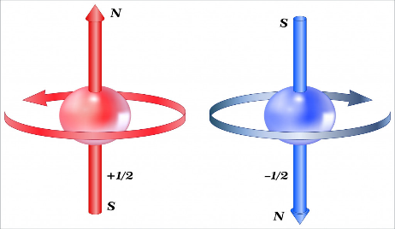
The electron can spin in two directions:
Spin up
Spin down
The spin up and spin down directions correspond to the spinning in the “+z” or “–z” direction.
These spins (spin up and spin down) are the particles that have spin “s” equal to 1/2, i.e. for electrons.
Electron Spin Theory
Fig. 1.3 Electron Spinning

Slide 19
Pauli Exclusion Principle
No two electrons in an atom may have the same set of quantum numbers.
This together with the idea that atoms will occupy the lowest energy levels available allows us to understand the Periodic Table .

Slide 20
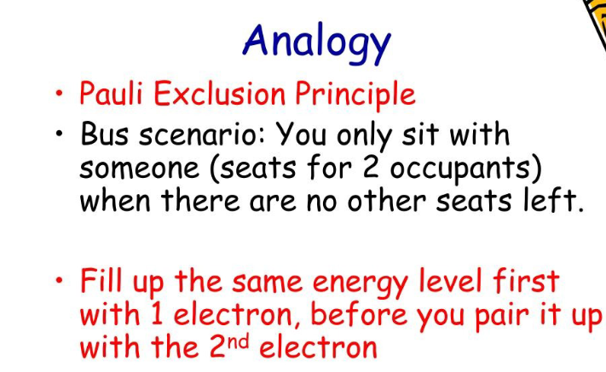

Slide 21
Hund's rule of maximum multiplicity
Hund's rule of maximum multiplicity is a rule based on observation of atomic spectra, which is used to predict the ground state of an atom or molecule with one or more open electronic shells
The rule states that for a given electron configuration, the lowest energy term is the one with the greatest value of spin multiplicity .
This implies that if two or more orbital's of equal energy are available, electrons will occupy them singly before filling them in pairs.

Slide 22
Hund's rule of maximum multiplicity
Before any two electrons occupy an orbital in a subshell, other orbitals in the same subshell must first each contain one electron.
Also, the electrons filling a subshell will have parallel spin before the shell starts filling up with the opposite spin electrons (after the first orbital gains a second electron).
As a result, when filling up atomic orbitals, the maximum number of unpaired electrons (and hence maximum total spin state) is assured.

Slide 23
Atomic And Molecular Bonds
The forces that hold atoms and molecules together in chemical compounds are known as molecular and atomic bonds.
Stable structures created as a result of the electrons interacting between atoms to form these bonds.
Studying and forecasting chemical reactions , material characteristics, and a ost of other phenomena in chemistry and materials science depend heavily on an understanding of atomic and molecular interactions.

Slide 24
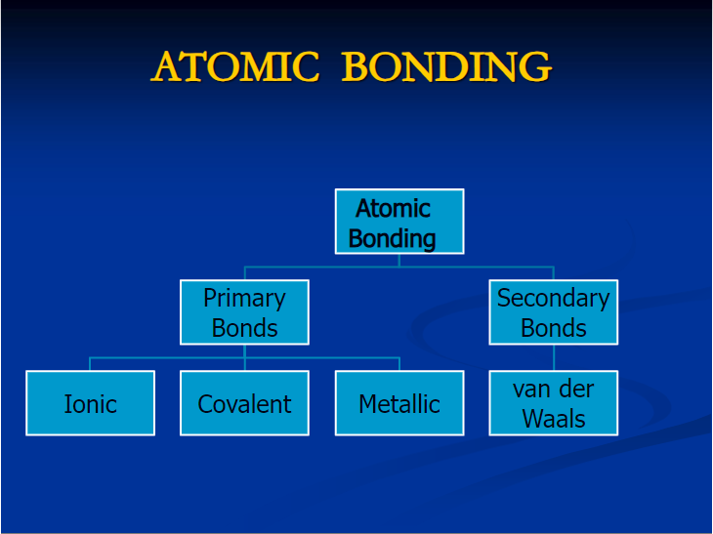

Slide 25
Types of atomic and molecular bonds
1. Covalent bonds
i. Polar Covalent Bonds
ii. Nonpolar Covalent Bonds
2. Ionic Bonds
3. Metallic Bonds
4. Hydrogen Bonds
5. Secondary Bonding
i. Dipole-Dipole Interactions
ii. London Dispersion Forces
iii. Ion-Dipole Interactions

Slide 26
Types of atomic and molecular bonds
6. Mixed Bonding
7. Hybridization Bonding
i. sp Hybridization
ii. Sp² Hybridization
iii. Sp³ Hybridization

Slide 27
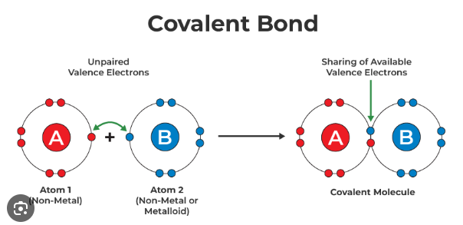
Covalent Bond
Covalent bonds are formed when atoms share electrons to establish a stable electron configuration .
There are two different Covalent bonds
i. Polar Covalent Bonds
ii. Nonpolar Covalent Bonds

Slide 28
Polar Covalent Bonds [Unequal share of Electrons]
A polar covalent bond occurs when there is an unequal sharing of electrons between two atoms.
This unequal sharing is a result of the difference in electronegativity between the two atoms.
Electronegativity is a measure of an atom's ability to attract electrons. When the electronegativity difference between atoms is significant (but not large enough to form an ionic bond), the electron pair is pulled more towards the more electronegative atom.
As a result, one end of the molecule has a partial negative charge, and the other end has a partial positive charge, creating a dipole moment.
Examples of molecules with polar covalent bonds include water (H2O) and hydrogen fluoride (HF).

Slide 29
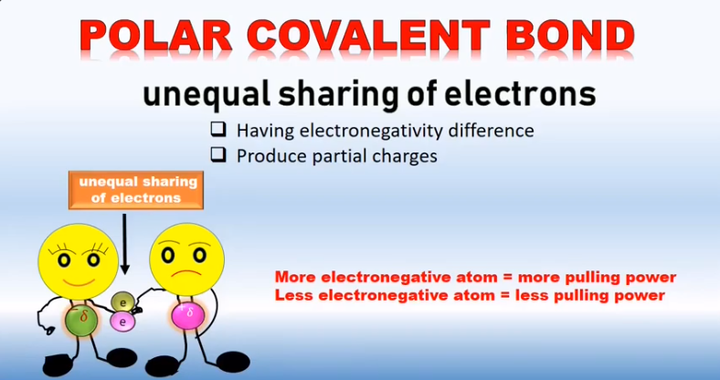

Slide 30
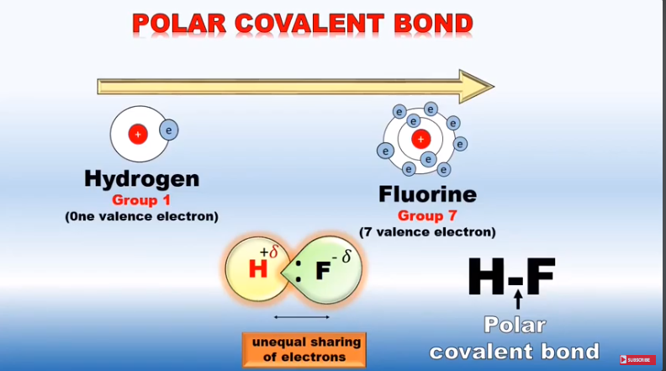

Slide 31
Nonpolar Covalent Bond [Equal share of Electrons]
A nonpolar covalent bond occurs when there is an equal sharing of electrons between two atoms.
This equal sharing is typically observed when the electronegativity difference between the atoms is very small or nonexistent.
In nonpolar covalent bonds, the electron pair is shared more or less equally between the atoms, and there is no significant dipole moment.
Examples of molecules with nonpolar covalent bonds include diatomic gases like hydrogen (H2) and oxygen (O2).

Slide 32
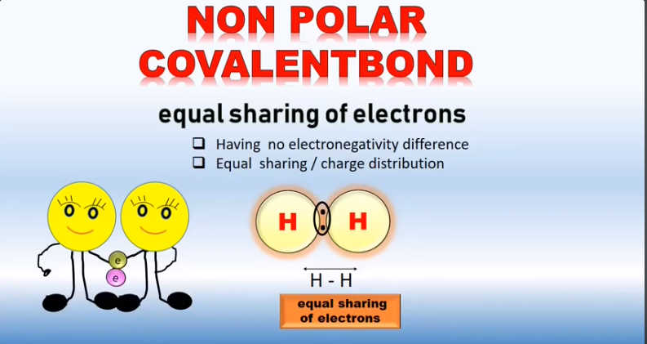

Slide 33
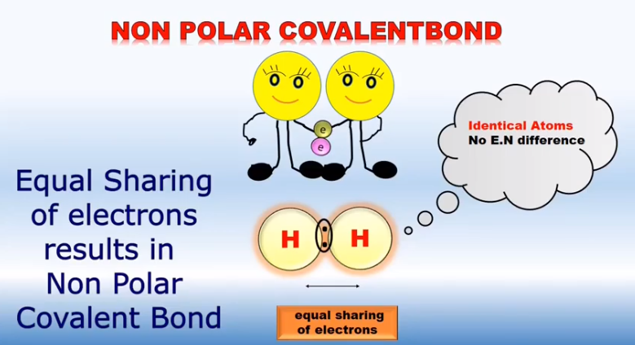

Slide 34
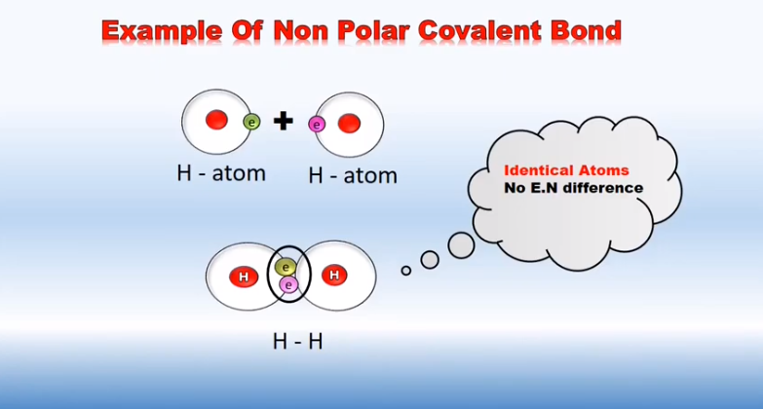

Slide 35
Ionic Bonds
Ionic bonding is a type of chemical bonding that occurs between atoms when there is a significant difference in electronegativity between them.
It typically involves the transfer of electrons from one atom to another, resulting in the formation of ions. Ionic bonds are commonly observed between metals and nonmetals.

Slide 36
Formation of Ions:
The metal atom loses electrons to achieve a stable, noble gas electron configuration, forming a positively charged ion (cation).
The nonmetal atom gains those electrons to achieve a stable, noble gas electron configuration, forming a negatively charged ion (anion).
Electrostatic Attraction:
The oppositely charged ions (cations and anions) are attracted to each other by electrostatic forces.
This attraction is what holds the ions together in an ionic bond.

Slide 37
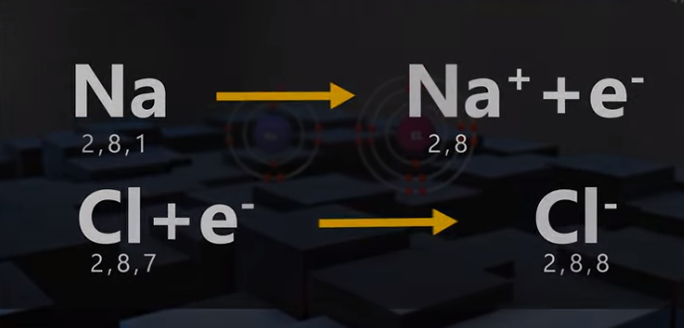

Slide 38
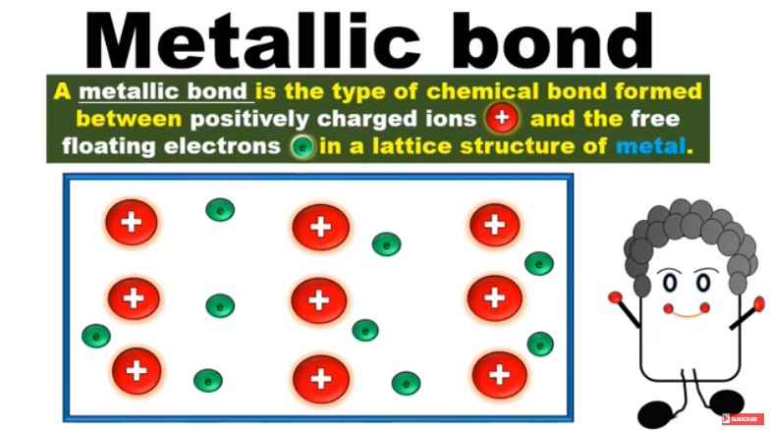
Metallic Bonds

Slide 39
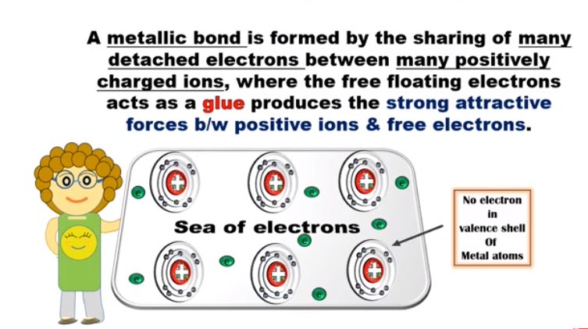

Slide 40
Metallic bonding
Metallic bonding is a type of chemical bonding that occurs between metal atoms. Unlike ionic or covalent bonds, metallic bonding doesn't involve the transfer or sharing of electrons between specific pairs of atoms. Instead, metallic bonding is a collective phenomenon where electrons are delocalized and free to move throughout the entire structure. This type of bonding is characteristic of metals.

Slide 41
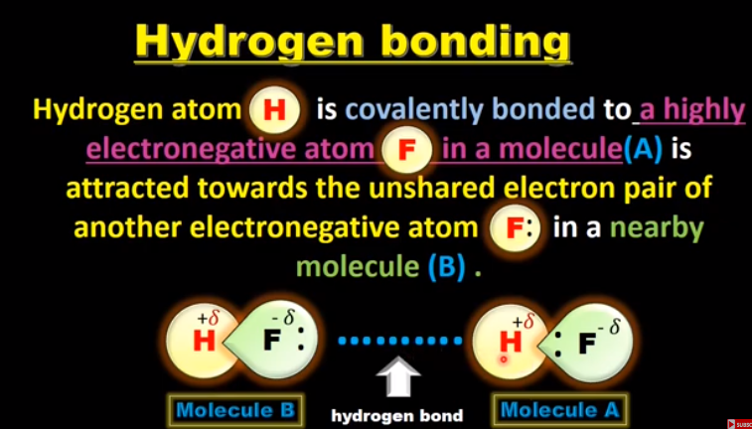
Hydrogen Bonding

Slide 42
Secondary Bonding
Secondary bonds, also known as van der Waals forces or London dispersion forces, are a type of intermolecular force that occurs between molecules or atoms. Unlike primary bonds (ionic, covalent, and metallic bonds), secondary bonds are generally weaker and are responsible for various physical properties of substances
Secondary bonds are bonds of a different kind to the primary ones. They are weaker in nature and are broadly classified as Van der Waal's forces and hydrogen bonds. These bonds are due to atomic or molecular dipoles, both permanent and temporary.

Slide 43
There are three main types of secondary bonds:
London Dispersion Forces (Van der Waals Dispersion Forces):
London dispersion forces are the weakest type of van der Waals forces.
They arise from temporary fluctuations in electron distribution around an atom or molecule, creating an instantaneous dipole moment.
This temporary dipole induces a dipole moment in neighboring atoms or molecules, leading to an attractive force between them.
London dispersion forces are present in all molecules, but they become more significant in larger, more polarizable molecules.

Slide 44
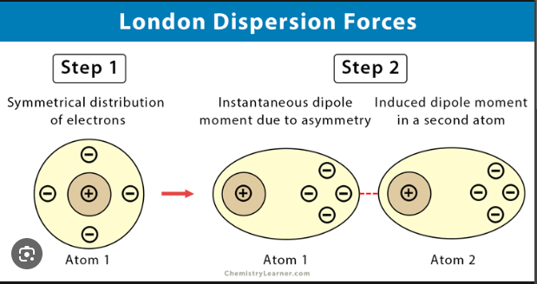

Slide 45
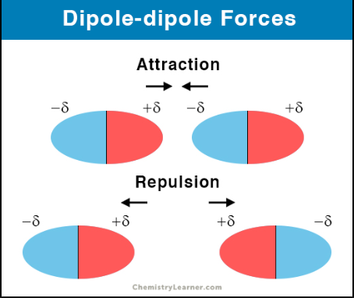
Dipole-Dipole Interactions:
Dipole-dipole interactions occur between polar molecules that have a permanent dipole moment.
In a polar molecule, there is an uneven distribution of electrons, leading to a separation of charges (positive and negative ends).
The positive end of one polar molecule is attracted to the negative end of another polar molecule, resulting in dipole-dipole interactions.
Dipole-dipole interactions are stronger than London dispersion forces but weaker than hydrogen bonds.

Slide 46
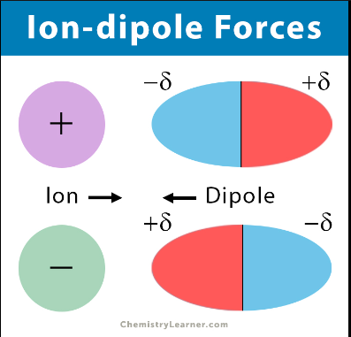
Ion-Dipole Bonding
Ion-dipole bonding is a type of intermolecular force that occurs between an ion and the partial charges (dipoles) of polar molecules.
This interaction is significant when ionic compounds are dissolved in polar solvents, such as water.
Ion-dipole interactions play a crucial role in the dissolution of salts and other ionic compounds in solution.

Slide 47
Mixed bonding
"Mixed bonding" typically refers to a situation in which a substance or a molecule exhibits a combination of different
types of chemical bonds.
The most common types of chemical bonds are ionic, covalent, and metallic bonds. The term "mixed bonding" might be used when a substance doesn't fit neatly into one of these categories and involves a combination of bond types.
the "mixed bonding" concept arises because the compound or substance doesn't conform strictly to the characteristics of one type of bond. The nature of the bonding in a substance is determined by the types of atoms involved, their electronegativities, and the arrangement of atoms in the structure. The concept of mixed bonding highlights the flexibility and complexity of chemical bonding in various compounds.

Slide 48
Hybridization Bonding
Hybridization is a concept in molecular orbital theory used to describe the mixing of atomic orbitals to form new hybrid orbitals. This process occurs when atoms combine to form molecules, and it helps explain the geometry and bonding in molecules.
Hybridization is invoked to explain molecular shapes and the types of bonds in molecules. For example, in methane (CH₄), the carbon atom undergoes sp³ hybridization, resulting in four equivalent hybrid orbitals that form tetrahedral geometry around the carbon atom.

Slide 49
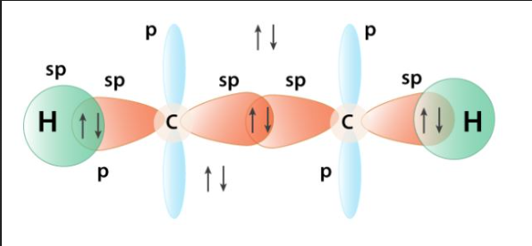
Hybridization types are sp hybridization, sp2 hybridization, sp3 hybridization.
sp hybridization: sp hybridization occurs when one s orbital and one p orbital combine to form two sp hybrid orbitals with a linear arrangement. These are linearly oriented at an angle of 180 degree to each other.
Eg: Acetylene

Slide 50
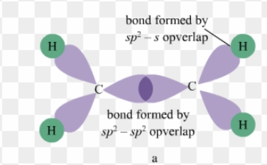
sp2 hybridization: sp2 hybridization occurs when one s orbital and two p orbital combine to form three sp2 hybrid orbitals.
These hybrid orbitals are trigonally oriented in a plane, with angles of 120 degree between them.
Eg: Ethylene.

Slide 51
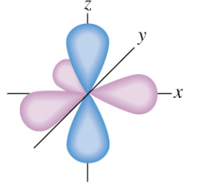
sp3 hybridization: sp3 hybridization occurs when one s orbital and three p orbital combine to form four sp3 hybrid orbitals.
These Hybrid orbitals are tetrahedrally oriented, with angles of approximately 109.5 degree between them.
Eg: Methane

Slide 52
Energy Bands in Metals
In solid-state physics, the concept of energy bands is crucial for understanding the electrical and thermal properties of materials. In metals, the energy band structure plays a significant role in determining their conductive properties.
The energy bands in metals are :
Valence Band and Conduction Band
The energy bands relevant to metals are the valence band and the conduction band.
The valence band is the band of energy levels occupied by electrons in their lowest energy states at absolute zero temperature.
The conduction band is the band of energy levels above the valence band that electrons can jump into, allowing them to move freely and conduct electricity.

Slide 53
Energy Gap (or Band Gap)
Unlike insulators and semiconductors, metals do not have a distinct energy gap between the valence and conduction bands.
In metals, the valence and conduction bands overlap, allowing electrons to move freely between them with very little energy.
Fermi Level
In metals, the Fermi level lies within the conduction band, indicating that electrons at absolute zero have enough energy to move freely.

Slide 54
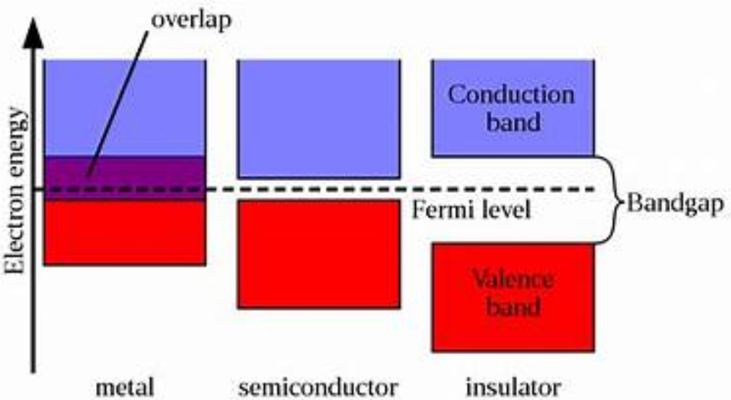

Slide 55
Energy Bands in Insulators
Insulators have a fully occupied valence band and an empty or partially filled conduction band, separated by a large energy gap. This large band gap is responsible for the insulating behavior of these materials, as it requires a significant amount of energy to promote electrons from the valence band to the conduction band.

Slide 56
Energy Bands in Semiconductor
The valence band is the energy band in which the electrons are tightly bound to the atoms. In this band, electrons are in their lowest energy state, and they are associated with the outermost (valence) electrons of the atoms. These electrons are not free to move easily through the material.
The conduction band is the energy band immediately above the valence band. Electrons in the conduction band are not bound to any specific atom and are free to move throughout the material. These electrons have higher energy levels and are responsible for the material's electrical conductivity.

Slide 57
Semiconductors with a small band gap are often referred to as "narrow-bandgap" semiconductors, while those with a larger band gap are "wide-bandgap" semiconductors.

Slide 58
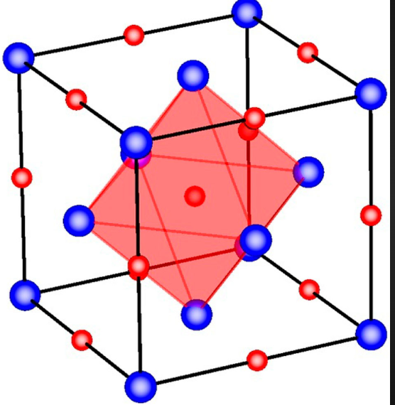
Basic Crystallography
Crystallography is the branch of science that studies the arrangement of atoms in solids. It plays a crucial role in understanding the properties of materials, including metals, minerals, and biological macromolecules.
The basic ideas of Crystallography are :
Crystal Structure: A crystal structure refers to the arrangement of atoms, ions, or molecules in a repeating three dimensional pattern. The repeating unit of a crystal structure is called a unit cell.

Slide 59
Unit Cell : The unit cell is the smallest repeating structure in a crystal lattice.
There are seven crystal systems based on the geometry of the unit cell: cubic, tetragonal, orthorhombic, rhombohedral, hexagonal, monoclinic, and triclinic.
Cubic : In a cubic crystal structure, the unit cell has equal edge lengths and angles of 90 degree. There are three types of cubic Structures: Simple Cubic, Body - Centric Cubic (BCC), and Face- Centric Cubic (FCC)

Slide 60
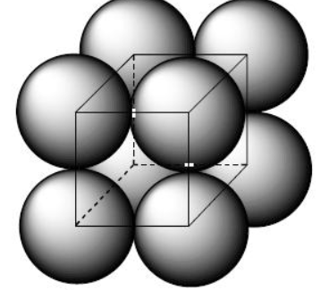
Simple Cubic : In a simple cubic structure, each lattice point (representing an atom or ion) is at the corner of a cube. The coordination number (number of nearest neighbors) for each atom in a simple cubic lattice is 6.

Slide 61
Body - Centric :
Unit Cell: The unit cell of a BCC structure is a cube with atoms at each of its eight corners and one atom at the center of the cube.
Coordination Number: Each atom in a BCC structure has a coordination number of 8, meaning it is in contact with 8 neighboring atoms.
Some metals that commonly adopt the BCC structure at certain temperatures include alpha-iron (α-Fe) at temperatures below 912°C and some alloys of chromium, molybdenum, and tungsten.

Slide 62
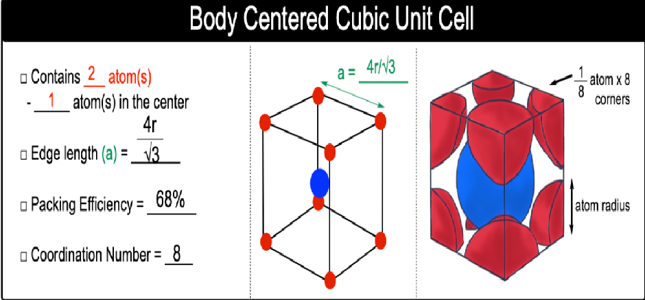

Slide 63
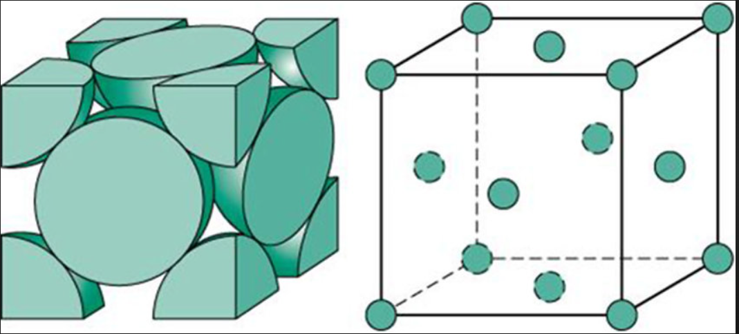
Face Centric :
In the face-centered cubic structure, atoms are arranged in a cubic lattice where there is an atom at each corner of the cube and an additional atom at the center of each face.
The coordination number, which is the number of nearest neighbors for each atom, is 12 in an FCC structure.

Slide 64
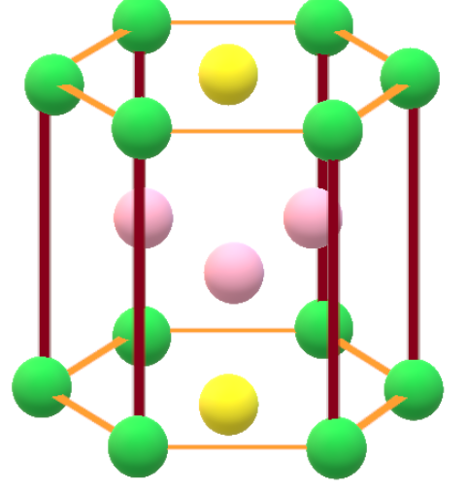
Hexagonal Close Packed Cell :
The term "Hexagonal Close Packed" (HCP) refers to a crystal structure commonly found in metallic and non metallic materials. The HCP structure is one of the close-packed arrangements of atoms in a crystal lattice. In the context of cubic cells, it's important to note that HCP is not cubic but hexagonal. The HCP structure is commonly found in metals like titanium and zinc.

Slide 65
Defects and Dislocations
Defects and dislocations are imperfections in the regular, ordered arrangement of atoms in a crystal lattice. These imperfections can significantly influence the physical, chemical, and mechanical properties of materials.

Slide 66
Point Defects:
Vacancy Defects:
Description: Occur when an atom is missing from its regular lattice site.
Effect: Reduces density, can enhance diffusion, and affects electrical conductivity.
Interstitial Defects:
Description: Atoms occupy positions in the crystal structure where no atom is supposed to be.
Effect: Can increase density, influence mechanical properties, and affect diffusion.
Substitutional Defects:
Description: Atoms are replaced by a different type of atom.
Effect: Alters the chemical and physical properties of the material.

Slide 67
Line Defects:
Dislocations:
Description: Linear defects that occur when there is a mismatch in the arrangement of atoms along a line in the crystal lattice.
Types:
Edge Dislocation: Extra half-plane of atoms is introduced, creating a region with excess energy.
Screw Dislocation: Spiral or helical distortion in the lattice structure.
Mixed Dislocation: Combines characteristics of both edge and screw dislocations.
Effect: Affects material strength, deformation behavior, and plasticity.

Slide 68
Planar Defects:
Grain Boundaries:
Description: Interfaces between crystalline grains with different orientations.
Effect: Influence mechanical properties, electrical conductivity, and corrosion resistance.
Twin Boundaries:
Description: Planar defects where there is a mirror image relationship between adjacent crystal regions.
Effect: Affects mechanical properties and electrical behavior.
Stacking Faults:
Description: Occur when there is a deviation from the regular stacking sequence of close-packed planes.
Effect: Influences crystal stacking and can affect material properties.

Slide 69
Surface Defects:
Surface Steps and Terraces:
Description: Irregularities on the surface due to variations in the number of atomic layers.
Effect: Influence surface properties, adhesion, and reactivity.

Slide 70
Types of Materials
Materials can be divided into several sorts according to their composition, usage and qualities.
Metals: Metals are a class of elements characterized by certain properties, including conductivity, malleability, ductility, and luster. some key characteristics and properties of metals:
Conductivity: Metals are generally good conductors of heat and electricity. This property is due to the presence of free electrons that can move freely within the metal structure.
Malleability: Metals can be hammered or rolled into thin sheets without breaking. This property is due to the ability of metal atoms to slide past each other in a regular pattern.
Ductility: Metals can be drawn into thin wires without breaking. Like malleability, ductility is related to the ability of metal atoms to move and slide past each other.
Luster: Metals typically have a shiny or metallic luster, reflecting light in a characteristic way.
Solid State at Room Temperature: Most metals are solid at room temperature. Mercury is an exception, as it is a metal that is liquid at room temperature.
High Melting and Boiling Points: Metals generally have high melting and boiling points compared to non-metals.
Density: Metals are generally dense materials.
Sonorous: Metals produce a characteristic ringing sound when struck, which is why they are often used in musical instruments.
Corrosion: Many metals can corrode or oxidize when exposed to the environment. However, some metals form a protective oxide layer that prevents further corrosion (e.g., aluminum and stainless steel).
Ductile to Brittle Transition: Some metals may exhibit a transition from ductile to brittle behavior at low temperatures.

Slide 71
Metal Alloys : Metal alloys are materials composed of two or more metallic elements or a metallic element and a non-metallic element. They are created by combining metals to enhance specific properties, such as strength, hardness, durability, corrosion resistance, and more. Here are some common metal alloys:
Steel: Iron alloyed with carbon is the most well-known alloy, known as steel. The carbon content can vary, leading to different types of steel with varying properties.
Stainless Steel: This is a type of steel alloy that contains chromium, nickel, and sometimes other elements. Stainless steel is corrosion-resistant and has various applications, including kitchen utensils, cutlery, and medical instruments.
Bronze: Copper alloyed with tin forms bronze. It has been widely used for casting sculptures, making tools, and creating musical instruments.

Slide 72
4. Brass: This alloy consists of copper and zinc. Brass is known for its yellowish color and is used in musical instruments, decorative items, and plumbing fixtures.
5. Aluminum Alloys: Aluminum can be alloyed with various elements such as copper, zinc, manganese, and others to create aluminum alloys. These alloys are lightweight and corrosion-resistant, making them popular in aerospace, automotive, and construction industries.
6. Titanium Alloys: Titanium can be alloyed with elements like aluminum and vanadium to form strong and lightweight alloys. These are often used in aerospace, medical implants, and sports equipment.
7. Copper-Nickel Alloys: These alloys, such as Cupronickel, combine copper with nickel and sometimes other elements. They are known for their resistance to corrosion and are commonly used in marine applications.
8. Monel: This is a nickel-copper alloy with small amounts of other elements. Monel is resistant to corrosion and used in applications such as marine engineering, chemical processing, and aerospace.
9. Invar: This is an iron-nickel alloy with a low coefficient of thermal expansion. It is used in applications where dimensional stability is critical, such as precision instruments.
10. Hastelloy: These nickel-based alloys contain elements like molybdenum and chromium. Hastelloy alloys are corrosion-resistant and used in aggressive chemical environments.

Slide 73
Polymers :
Polymers are large molecules composed of repeating structural units, called monomers. These molecules can have a wide range of sizes and structures, and they play a crucial role in various natural and synthetic materials.
There are two main types of polymers:
Natural Polymers:
Proteins: Proteins are natural polymers made up of amino acid monomers. Examples include collagen, keratin, and enzymes.
Nucleic Acids: DNA (deoxyribonucleic acid) and RNA (ribonucleic acid) are polymers of nucleotide monomers, carrying genetic information in living organisms.
Polysaccharides: Carbohydrates like cellulose, starch, and glycogen are natural polymers composed of sugar monomers.
Synthetic Polymers:
Polyethylene: Commonly used in packaging materials, polyethylene is a synthetic polymer with a wide range of applications, including plastic bags and containers.
Polypropylene: Used in textiles, packaging, and automotive components, polypropylene is a versatile polymer with high chemical resistance.
Polyvinyl Chloride (PVC): Widely used in construction, PVC is a polymer with applications in pipes, cable insulation, and vinyl siding.
Polystyrene: Used in packaging materials and foam products, polystyrene is a lightweight and rigid polymer.
Polyester: Found in fabrics and clothing, polyester is a synthetic polymer known for its durability and resistance to wrinkles.

Slide 74
3. Biodegradable Polymers:
Polylactic Acid (PLA): Derived from renewable resources like corn starch, PLA is used in biodegradable plastics and packaging.
Polyhydroxyalkanoates (PHA): These biodegradable polymers are produced by bacteria and can be used in various applications, including packaging.
4. Functional Polymers:
Conducting Polymers: Polymers that conduct electricity, such as polyaniline, have applications in electronic devices.
Smart Polymers: Responsive to external stimuli like temperature, pH, or light, smart polymers have applications in drug delivery systems and sensors.
5. Applications:
Plastics: The majority of plastics are made from synthetic polymers and are used in countless products.
Textiles: Synthetic polymers like polyester and nylon are commonly used in clothing and fabrics.
Medicine: Biodegradable polymers are used in drug delivery systems, and polymers are employed in medical devices.
Adhesives and Sealants: Many adhesives and sealants are based on polymer chemistry.
Electronics: Conducting polymers are used in the production of electronic components.

Slide 75
Ceramic Materials :
Ceramic materials are a diverse class of inorganic, non-metallic solids that exhibit a wide range of properties, making them suitable for various applications. These materials are typically composed of metallic and non-metallic elements, often with oxygen, nitrogen, or carbon. Ceramic materials are known for their hardness, high melting points, electrical insulation properties, and resistance to wear and corrosion. Here are some key aspects of ceramic materials:
Types of Ceramics:
Traditional Ceramics: Includes pottery, bricks, tiles, and porcelain. These ceramics are based on clay and other natural minerals.
Advanced Ceramics: Engineered ceramics with specific properties for modern applications. Examples include alumina, silicon carbide, and zirconia.
Properties:
Hardness: Ceramics are generally hard and brittle, which makes them suitable for cutting tools, abrasives, and protective coatings.
High Melting Point: Ceramics often have high melting points, making them resistant to high temperatures and suitable for applications in extreme environments.
Electrical Insulation: Many ceramics are good electrical insulators, making them essential in electronics and electrical applications.
Chemical Resistance: Ceramics can resist corrosion and chemical attack, making them useful in harsh chemical environments.

Slide 76
3. Applications:
Electronics: Ceramics are used in the manufacturing of capacitors, insulators, and piezoelectric devices.
Construction: Ceramics are used in tiles, bricks, and structural components due to their durability and resistance to weathering.
Biomedical: Ceramics like alumina and zirconia are used in dental implants and artificial joints due to their biocompatibility and resistance to wear.
Aerospace: Ceramics are used in heat-resistant components, such as thermal protection systems for spacecraft.
Automotive: Ceramics are used in brake systems, engine components, and catalytic converters due to their heat resistance and wear resistance.
4. Common Ceramic Materials:
Alumina (Al2O3): Widely used for its high hardness, electrical insulation, and chemical resistance.
Zirconia (ZrO2): Known for its high strength, toughness, and resistance to wear. Used in dental implants and cutting tools.
Silicon Carbide (SiC): Exhibits high thermal conductivity, hardness, and resistance to wear. Used in abrasive materials and high-temperature applications.
Titanium Dioxide (TiO2): Used in ceramics for its white color and opacity, common in the production of porcelain and glazes.

Slide 77
5. Processing Techniques:
Sintering: The process of compacting and forming a solid mass of material by heat or pressure without melting it to the point of liquefaction.
Ceramic Coating: Applying thin ceramic layers to the surface of a substrate for enhanced properties like hardness, wear resistance, and corrosion resistance.
6. Challenges:
Brittleness: Ceramics can be brittle, leading to challenges in manufacturing and handling.
Processing Complexity: Some advanced ceramics require precise processing techniques, adding to the overall cost.
Limited Ductility: Ceramics generally have low ductility, limiting their use in applications requiring deformation.

Slide 78
Composite Materials :
Composite materials are engineered materials made from two or more constituent materials with significantly different physical or chemical properties that, when combined, produce a material with characteristics different from the individual components. The goal of using composite materials is often to achieve a combination of desirable properties such as strength, stiffness, lightness, and durability that may not be achievable with traditional materials like metals, ceramics, or polymers alone.
Matrix Material: This is the material that surrounds and binds together the reinforcement materials. It is usually a polymer, metal, or ceramic. The matrix holds the reinforcement materials in place and transfers loads between them.
Reinforcement Material: This material provides strength and stiffness to the composite. It is typically in the form of fibers, particles, or sheets. Common reinforcement materials include carbon fibers, glass fibers, aramid fibers, and various types of particles.

Slide 79
Common types of composite materials include:
Fiber-Reinforced Composites:
Carbon Fiber Reinforced Polymer (CFRP): Combining carbon fibers with a polymer matrix results in a lightweight and high-strength material used in aerospace, automotive, and sporting goods.
Glass Fiber Reinforced Polymer (GFRP): Glass fibers combined with a polymer matrix create a material that is strong, relatively inexpensive, and corrosion-resistant.
Particle-Reinforced Composites:
Metal Matrix Composites (MMC): Metal matrices reinforced with ceramic particles or fibers to improve properties like strength, wear resistance, and thermal stability.
Polymer Matrix Composites (PMC): Polymer matrices reinforced with various particles or fibers to enhance mechanical properties.
Laminates:
Fiber-Reinforced Laminates: Layers of fiber-reinforced materials are stacked and bonded together to create a laminate. This is common in structures like composite aircraft components and sporting goods.
Natural Fiber Composites:
Biocomposites: Use of natural fibers like flax, hemp, or jute in combination with a polymer matrix to create more environmentally friendly materials.

Slide 80
Semiconductor Materials :
Semiconductor materials are crucial components in the fabrication of electronic devices, serving as the foundation for the construction of integrated circuits (ICs) and other electronic components. These materials possess unique electrical properties that make them suitable for controlling and manipulating the flow of electrical current. Here are some key semiconductor materials:
Silicon (Si): Silicon is the most widely used semiconductor material. It is abundant, has excellent semiconductor properties, and forms the basis of most modern electronic devices. Silicon wafers are commonly used as the substrate for manufacturing integrated circuits.
Germanium (Ge): Germanium was one of the first semiconductor materials used in the early days of electronics. It has some advantages, but silicon eventually became more popular due to its better thermal stability and manufacturing characteristics. Germanium is still used in some niche applications.
Gallium (Ga) and Arsenic (As): Gallium arsenide (GaAs) is a compound semiconductor with unique properties that make it suitable for high-frequency applications, such as in microwave devices and certain types of transistors.
Gallium Nitride (GaN): Gallium nitride is a wide-bandgap semiconductor material used in the production of high-power and high-frequency devices. It is commonly found in applications such as LEDs, power amplifiers, and RF devices.
Indium Phosphide (InP): InP is another compound semiconductor with properties suitable for high-speed electronic and optoelectronic devices. It is often used in the production of high-frequency transistors and photonic devices.

Slide 81
6. Silicon Carbide (SiC): Silicon carbide is a wide-bandgap semiconductor material known for its high-temperature stability and excellent thermal conductivity. It is used in power electronics, high-power RF devices, and applications requiring high-temperature resistance.
7. Organic Semiconductors: Organic semiconductors are made from carbon-based compounds. They are utilized in organic electronics and are commonly found in organic light-emitting diodes (OLEDs), organic photovoltaic cells, and organic field-effect transistors.
8. Perovskite: Perovskite materials have gained attention for their potential use in solar cells. Perovskite solar cells have shown promise due to their low-cost manufacturing and high efficiency.

